Slide 1
Fugitive Workbook Walkthrough
Louis Malarcher
Air Permits Division
Advanced Air Permitting Seminar 2022

Slide 2
Equipment Leak Fugitive Background
What is included in fugitive emissions?
Common Components
Valves, Pumps, Flanges/connectors, Compressors, Relief valves, Open-ended lines, Process drains
Unique Components
Components not included in common list
Examples: screwed fittings, site glasses, metal-to-metal seals

Slide 3
Common TCEQ LDAR Programs
28M - BACT for uncontrolled fugitive emission $≥$ 10 TPY
28VHP - BACT for uncontrolled fugitive emissions $≥$ 25 TPY
Uncontrolled emissions based on calculation without any LDAR program reduction credit
28RCT - Chapter 115 for VOC fugitives where 28VHP not required
28AVO - Odorous compounds (chlorine, ammonia, etc.)

Slide 4
Before Counting Components
Are emissions included in other calculations?
i.e.: tank fittings included in tank emission calculations
Are parts of components otherwise counted?
i.e.: seals / bearings that are part of a pump are already accounted for with the pump
Is the vapor pressure < 0.002 psia?
Permitting Guidance (APDG 6422): VOC emissions from mixtures where aggregate partial pressure < 0.002 psi at 68°F do not need to be quantified
Not the same as memo “When should a compound be considered an air contaminant” vapor pressure < 0.002 psia at 104°F is case-by-case

Slide 5
Equipment Credits
All fugitive components must be included in component counts, even if they are given 100% credit.
Examples:
Components where potential emission routed to control
Canned or magnetic drive pumps
Open-ended lines with a cap, blind flange, plug, or second valve
Bellow valves with bellow welded to both the bonnet and stem
Diaphragm-type valves
See Section on Equipment Credits in Permitting Guidance (APDG 6422) for complete list of options

Slide 6
Fugitive Workbooks
Version 1.0 (no longer available)
2 workbook options; 25 speciation and 100 speciation
Released January 8, 2021
Required with applications after April 1, 2021
Version 2.0
4 workbook options; based on fugitive factor
Released April 1, 2021
Required with applications after April 1, 2021
Version 3.0
1 workbook option
Released October 1, 2022
Required with applications after January 1, 2023

Slide 7
Recent Updates
The workbook released October 1, 2022 includes
New Summary tab calculated from other tabs for lb/hr and tpy of
Total emissions
Total VOC
Total Inorganic
Total Exempt Solvent
Tpy only for Total GHG mass and CO2e
All industries brought back into one workbook
(no more distinction by workbook)

Slide 8
Other Changes
Will now have ability to add up to three LDAR programs:
Instrument monitoring
Connector monitoring
Physical Inspection monitoring
More tabs for entering component counts
Detailed instructions at the top of each calculation sheet
Detailed footnotes at the bottom of each calculation sheet

Slide 9
Structure of Version 3.0
Instructions tab
Summary tab
Fug (1) through (25) tabs
Locked tabs
Species
Industry, Components, Service
LDAR Programs
Helper Variable and Lists
Global Warming Potentials

Slide 10
Fug (1) tab
Same as (2) through (25)
Divided into 8 sections
General Information
Industry, Pollutant type and Emission Factors
Control Efficiencies
Emission Rates
Emission Rates – Unique Components
Speciation (non-GHG)
Speciation (GHG)
Emission Summary for Worksheet
Footnotes

Slide 11
I. General Information

Slide 12
II. Industry, Pollutant Type and Emission Factors
Note down arrow at bottom right of row 13. Indicates selection to be made from picklist. Shows up when the cell is selected.

Slide 13
III. Control Efficiencies

Slide 14
III. Control Efficiencies (cont.)

Slide 15
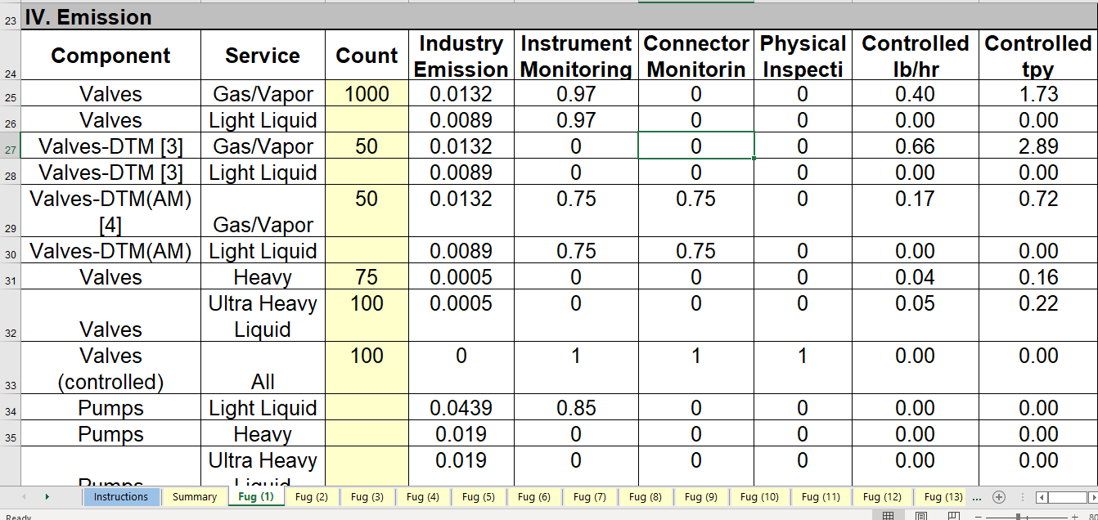
IV. Emission Rates

Slide 16
Sampling Connections
Exception for how hourly and annual emissions calculated
Based on the number of samples taken rather than component
Two rows
Hourly
Annual

Slide 17
Process Drains
Control efficiency determined by §115.324(1)(C) and §115.354(1)(A) instead of LDAR

Slide 18
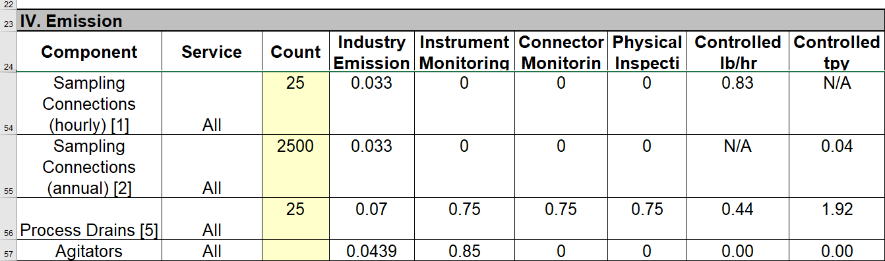
IV. Emission Rates (cont.)

Slide 19
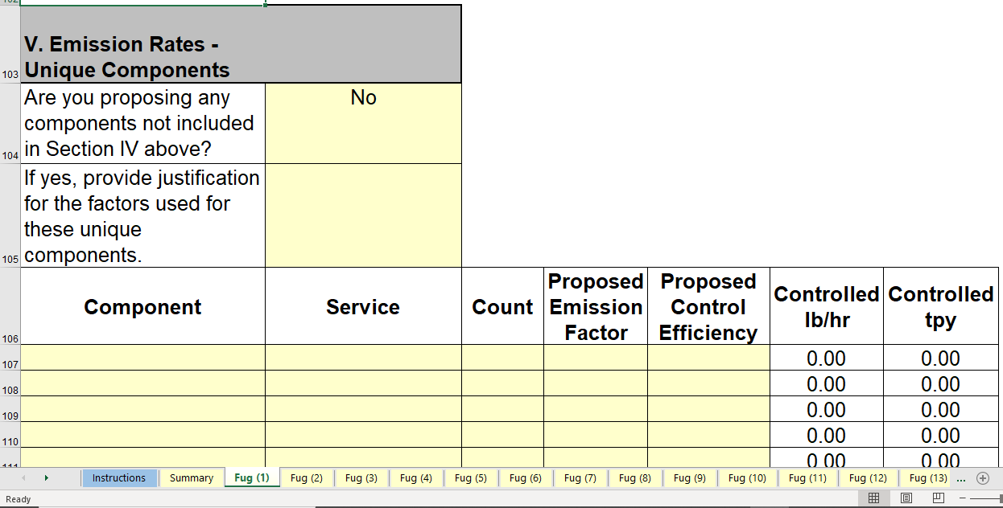
V. Emission Rates – Unique Components

Slide 20
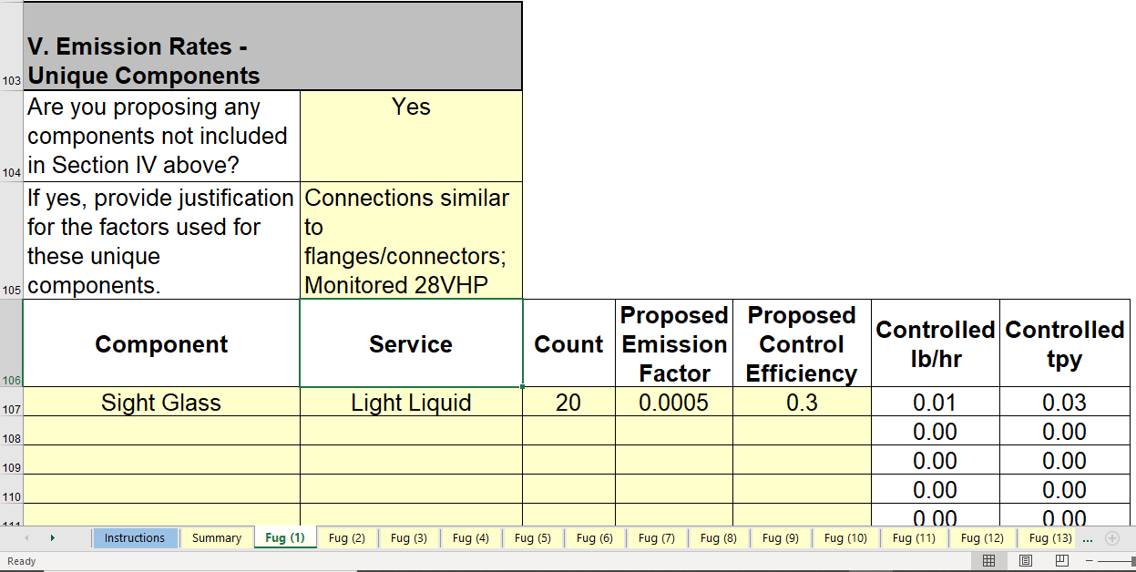
V. Emission Rates – Unique Components Filled In

Slide 21
VI. Speciation (non-GHG)

Slide 22
Section VI. Speciation (non-GHG)
Yes/No identification for VOC, Inorganic, VOC-Exempt Solvent, Inert (i.e.: nitrogen, air, water) – only answer one with Yes
CAS # column tied to pick-list – Mark as N/A to activate “Other Species” column
Weight Percent can exceed 100%
Short cut if all VOC; can leave speciation empty, Yes for VOC, and 100%. Speciating will help with impacts modeling

Slide 23
VII. Speciation (GHG)

Slide 24
VIII – Emission Summary for Worksheet

Slide 25
Summary tab

Slide 26
Summary tab – VOC and Inorganic

Slide 27
Summary tab – Exempt Solvent and GHG

Slide 28
Calculation for multiple LDAR
Emissions based on maximum control efficiency
Control efficiencies not additive
Example:
Flanges/Connectors in Light Liquid Service
28VHP = 30% Control
28CNTA = 75% Control
28AVO = 97% Control
28AVO would require detectable odorous compound

Slide 29
Math for Example
Number of components = 1,000
SOCMI Average Emission Factor = 0.0005 lb/component – hour
Correct calculation:
1,000 x 0.0005 x (100% - 97%) = 0.015 lb/hr
0.015 lb/hr x 8,760 hours / 2,000 lbs/ton = 0.0657 tpy
Workbook shows:
0.02 lb/hr and 0.07 tpy

Slide 30
Important Workbook Dates
Version 1.0 no longer accepted
Version 2.0 of the fugitive workbook is required for all New Source Review applications with fugitive emissions received on or after April 1, 2021.
Version 2.0 no longer accepted after January 1, 2023
Version 3.0 posted October 1, 2022 will be required for all New Source Review applications with fugitive emissions received on or after January 1, 2023.

Slide 31
Contact Information
Louis Malarcher, P.E.
Phone: (512) 239-1151
Email: Louis.Malarcher@tceq.Texas.gov
Kevin Villalta
Phone: (512) 239-6044
Email: Kevin.Villalta@tceq.Texas.gov
General
Phone: (512) 239-1250
Email: airperm@tceq.Texas.gov

