Slide 1
Title VI and Air Permitting
Beryl Thatcher, Assistant Deputy Director
Air Permits Division
Advanced Air Permitting Seminar 2022

Slide 2
Topics of Discussion
Public Participation and Language Access Plans
Chapter 39 Notice Requirements
Public Involvement Plans

Slide 3
Informal Resolution Agreement
Title VI complaint filed in 2019
Informal Resolution Agreement signed in November 2020
Commitment to develop plans
Training and stakeholder engagement
Public Participation Plan
Language Access Plan
Plans may be found at https://www.tceq.texas.gov/agency/decisions/participation/title-vi-compliance

Slide 4
Public Participation Plan
Established in June 2021
Public participation opportunities
Preliminary screening
Public Involvement Plan (PIP)
Notes:
Public Participation Plan was the first commitment in the Informal Resolution Agreement
Established last June
Provides guidance to the TCEQ staff, regulated community and the public in understanding the expectations for meaningful public participation
Includes preliminary screening efforts to reach under served communities
And when a Public Involvement Plan is needed for agency and permitting actions

Slide 5
Language Access Plan
Framework to identify individuals and communities that need language assistance
Description of TCEQ’s approach to providing language assistance
Guidelines for determining when translation and interpretation is needed by the TCEQ
Notes:
2nd commitment made under our Informal Resolution Agreement.
The plan was developed to enhance access for all and establish guidance to better ensure individuals with limited English proficiency may meaningfully access TCEQ programs, activities, and services.
The plan provides the framework to identify individuals and communities that need language assistance
Describes TCEQ’s approach to providing language assistance
Provides guidelines for determining when translation and interpretation is needed by the TCEQ

Slide 6
New Alternative Language Public Participation Rules
New requirements in Chapter 39 for alternative language notice
NORI
NAPD
Public Meetings
Response to Comments
Response to Hearing Requests
Plain language summary
Applicable to all applications subject to Chapter 39 and declared administratively complete on or after May 1, 2022
Notes:
A petition for rulemaking was filed with the commission in late 2019 by the Texas Environmental Justice Advocacy Services and Sierra Club
Rulemaking became effective September 17, 2021
Created new 39.426 for alternative language notice
New requirement for a plain language summary
These new requirements are for all applications subject to Chapter 39 and declared administratively complete on or after May 1

Slide 7
Changes for NORI and NAPD
New language in notice if alternative language requirement applies
Alternative language notices posted on agency website
Required even if applicant has a waiver from publication of notice in alternative language newspaper
Alternative language notice mailed by Office of the Chief Clerk (OCC) with the English notice
Notes:
There are changes to the NORI and NAPD notices themselves.
A sentence has been added to all notices for all media that will be in an alternative language saying where to go find the entire notice in the alternative language on the TCEQ website
Alternative language notices posted on agency website
Required even if no paper
Will be mailed with English notice
The agency is posting all notices subject to Chapter 39 on the webpage even if alternative language doesn’t apply

Slide 8
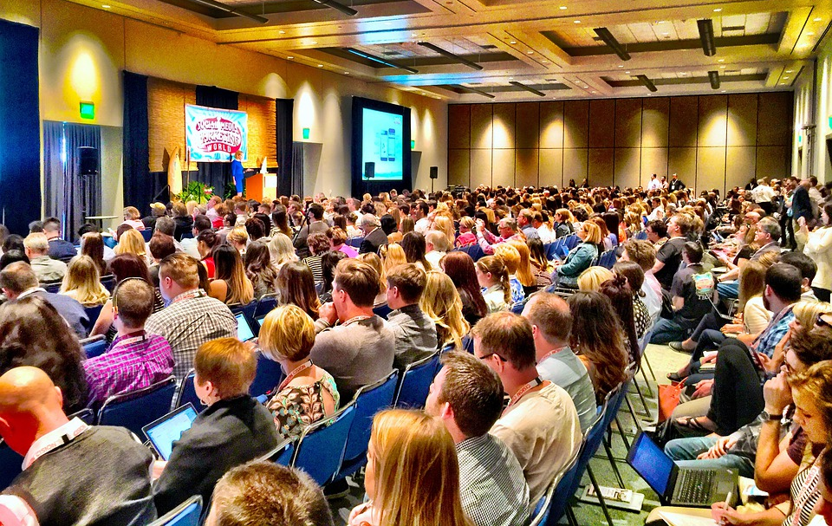
Public Meetings
Notice of public meeting in alternative language mailed by OCC
For air applications, must be mailed at least 30 calendar days prior to date of public meeting
Notice of public meeting in alternative language posted on TCEQ website
Interpreters may be required

Slide 9
Response to Comments
TCEQ must evaluate the need to provide a translated RTC when formal written or oral comments are received in an alternative language
May translate the RTC if the Executive Director determines there is significant public interest that would be served by the translation

Slide 10
Contested Case Hearing Requests
Responses to contested case hearing requests from the following must be translated if request is received in alternative language:
Executive Director
Office of Public Interest Council
Applicant
Notes:
If hearing request received in the alternative language
Not just because you had to publish in alternative language

Slide 11
Plain Language Summary
Plain language summary of the application which includes
Function of the proposed plant or facility
Expected output of the proposed plant or facility
Expected pollutants that may be emitted by the proposed plant or facility
How the applicant will control those pollutants
No more than 2 pages long
Must be translated if alternative language publication required
Posted to TCEQ website
Templates available on APD webpage
Notes:
Required for ALL APPLICATIONS subject to Chapter 39, not just if triggered alternative language notice
Always in ENGLISH, sometimes in alternative language
Unlike the notices, these are only POSTED and not mailed

Slide 12
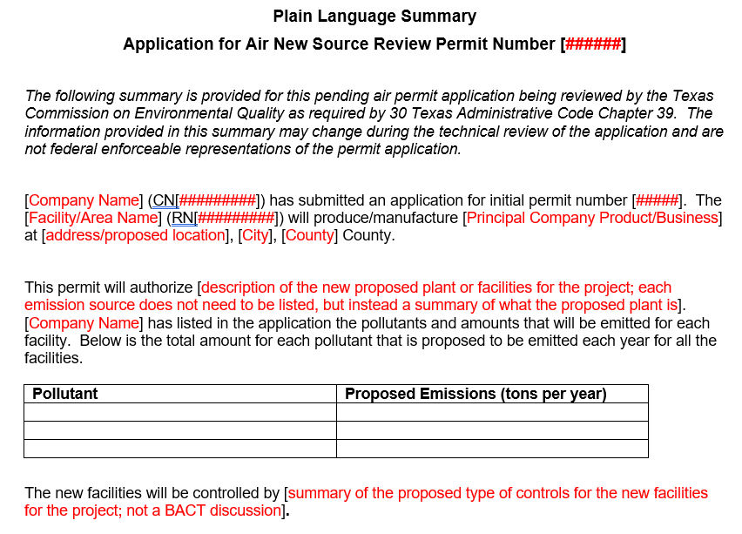
Plain Language Summary Continued
Notes:
Instructions say where to pull some of this information from the application
Key is to use plain language
Don’t say “controlled by a scrubber”
Give TIPS for completing based on what has been submitted since May

Slide 13
Public Involvement Plan (PIP)
Required for TCEQ actions, including
Rulemakings
State Implementation Plans
Required for Permitting
Applications received after November 1
Not only for applications subject to Chapter 39
Notes:
The plans will likely look different for each of these

Slide 14
Public Involvement Plan (PIP) continued
Completed by applicant using TCEQ form
Submitted with the application
Required for:
New applications and/or new activities requiring notice;
Significant public interest; and
Within the following geographical locations
Urban metroplexes
West Texas
Panhandle
Texas/Mexico border
Notes:
Must be all 3
Examples of when to do a PIP
Brand new application in Houston area with historically significant public interest
Amendment to add in a new kiln in Dallas in a limited English proficient community
Examples of when a NOT to do a PIP
Brand new application in Waco
Amendment that is just increasing throughput which has emissions increases that trigger notice
Rock crusher in San Angelo would be unlikely
PBRs will not require they don’t trigger notice
Could still do it voluntarily or the agency may ask you to do one.

Slide 15
Public Involvement Plan Worksheet for Permit and Registration Applications
TCEQ Form
Form 20960
Instructions
Sections for each media

Slide 16
Section 1 Preliminary Screening
New Permit or Registration Application
New Activity – modification, registration, amendment, facility, etc.

Slide 17
Section 2 Secondary Screening
Requires Notice,
Considered to have significant public interest, and
Located within any of the following geographical locations:
• Austin • San Antonio
• Dallas • West Texas
• Fort Worth • Texas Panhandle
• Houston • Along the Texas/Mexico Border
• Other geographical locations should be decided on a case-by-case basis

Slide 18
Section 3 Application Information
For Air, check all that will apply for the application
Initial
Federal
Amendment
Standard Permit
Title V

Slide 19
Section 4 Plain Language Summary
Provide a brief description of planned activities
If a plain language summary was required to be submitted with the application, it may be attached and referenced here

Slide 20
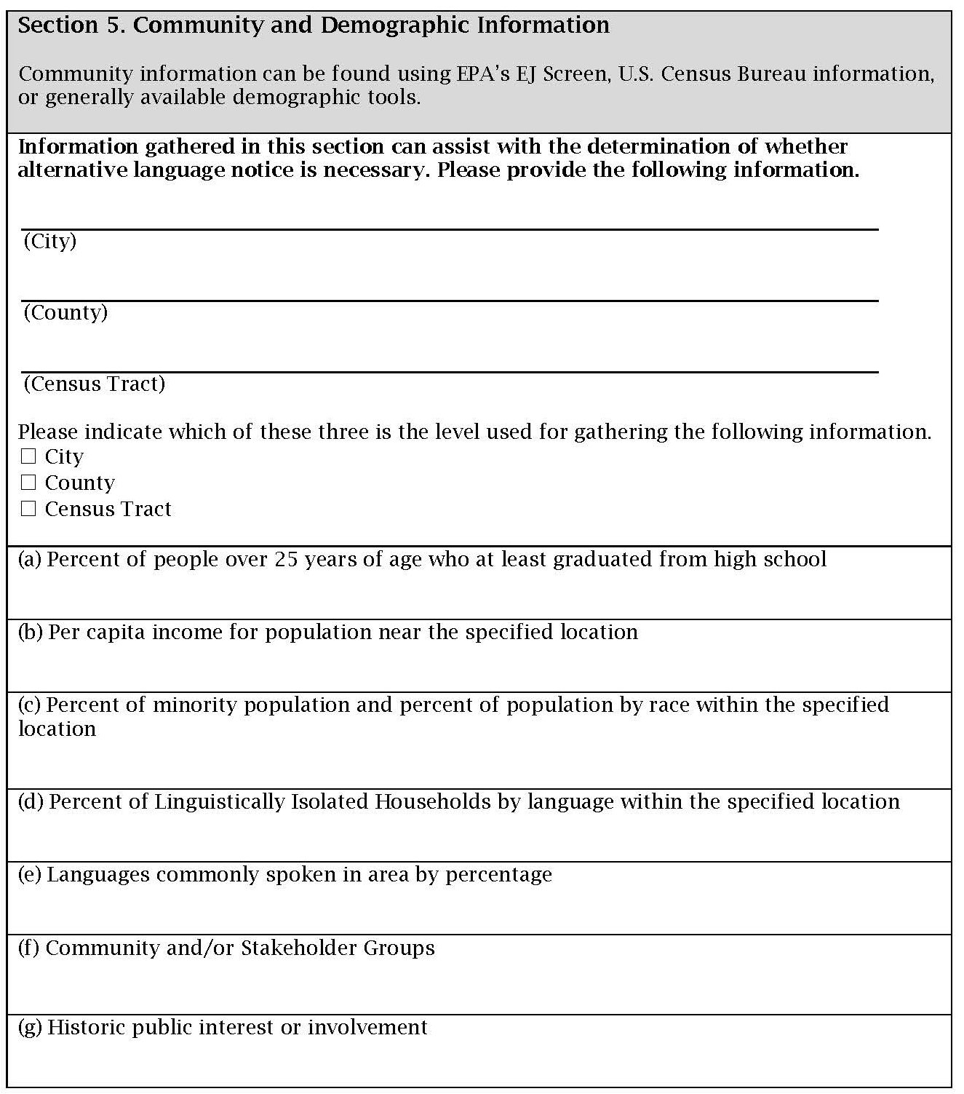
Section 5 Community and Demographic Information continued

Slide 21
Section 5 Community and Demographic Information
Information provided in this section is to assist in determining if alternative language notice is necessary
EPA’s EJ Screen and U.S. Census Bureau data may be used
Every part of Section 5 does not need to be completed
All air permits, regardless if they are subject to Chapter 39, must publish in alternative language if school has a bilingual program

Slide 22
Section 6 Planned Public Outreach Activities
Is the application subject to Chapter 39?
If yes, will outreach be provided other than what is required by rule?
If subject to Chapter 39, do not need to complete the rest of Section 6

Slide 23
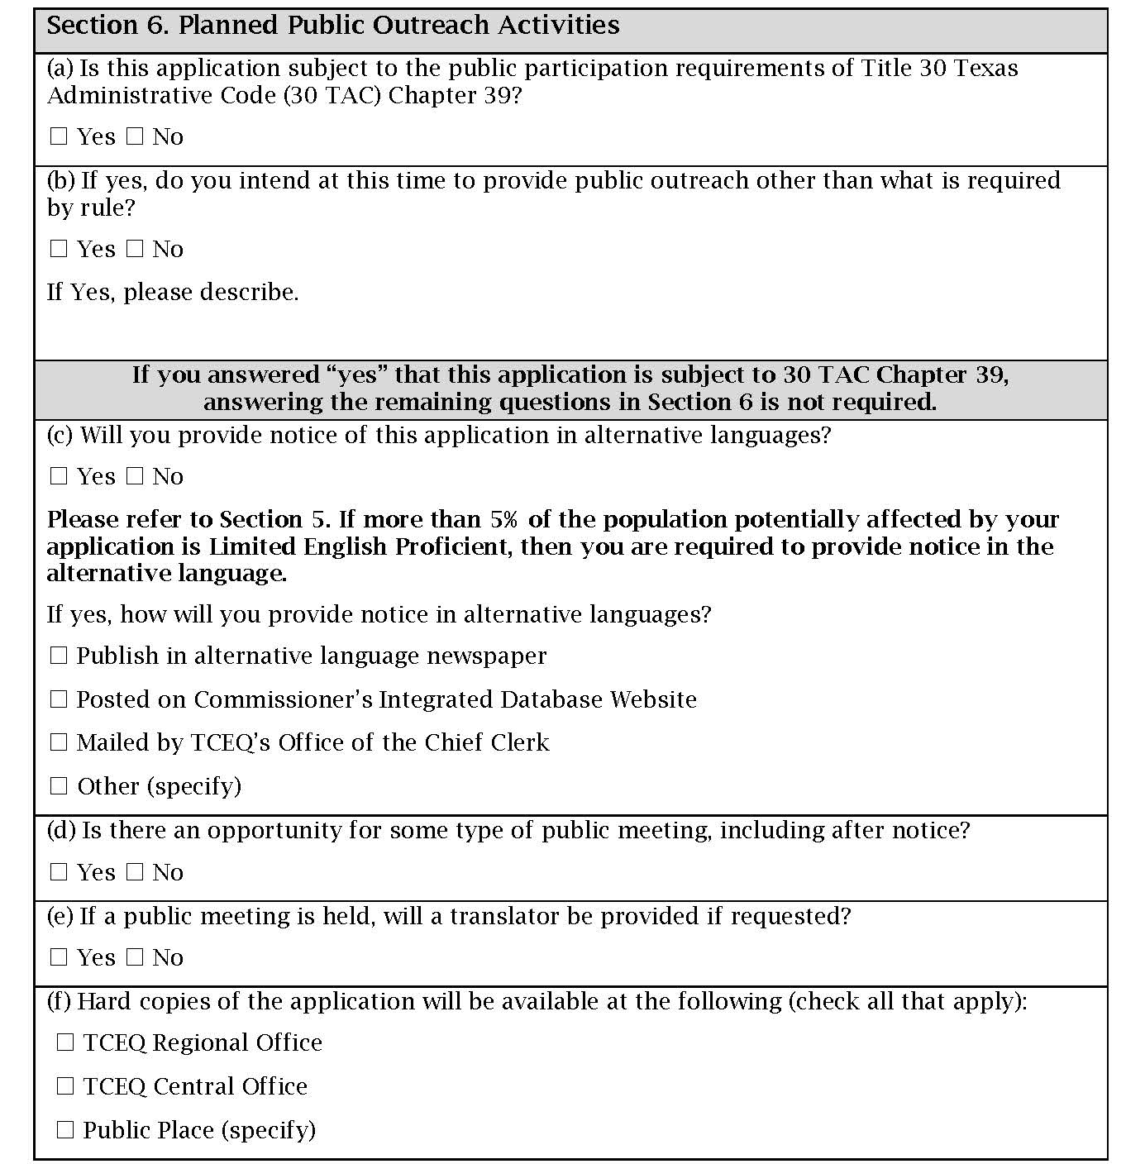
Section 6 Planned Public Outreach Activities 2

Slide 24
Section 6 Planned Public Outreach Activities (continued)1
Will notice be provided in alternative languages?
Is there an opportunity for some type of public meeting, including after notice?
Public meeting
Public hearing
Informational meeting
Notice and comment hearing

Slide 25
Section 6 Planned Public Outreach Activities (continued)2
If a public meeting is held, will a translator be provided if requested?
Hard copies of the application will be made available at the following
TCEQ Regional Office
TCEQ Central Office
Public Place

Slide 26
Section 7 Voluntary Submittal
This section is for applicants not subject to formal public participation requirements, but are voluntarily submitting the form
For air permits, this would only occur for very special circumstances

Slide 27
Outstanding Title VI Complaints
Earthjustice Title VI Complaint
PACAN Title VI Complaint
Joint Concrete Batch Plant Standard Permit Title VI Complaints
Petition for Title VI Compliance Review & SIP Call of TCEQ’s Air Permitting Program

Slide 28
What Next?
PIP will be available online and ready for use on November 1
Completed PIP Form should be included in ALL permit applications and standard permit registrations submitted after November 1
Agency IRA meetings will be held in November
Stay up to date by visiting TCEQ Title VI webpage

Slide 29
Contact Information
Beryl Thatcher
Phone: 512-239-2270
Email: beryl.thatcher@tceq.texas.gov
Bill Moody, P.E.
Phone: 512-239-1859
Email: william.moody@tceq.texas.gov

