Slide 1
Evaluation of Laboratory Methods to Quantify Chlorophyll-a
Phase I Results and Phase II Plans
8/5/2020

Slide 2
Background
Chlorophyll-a data submitted to SWQMIS is currently analyzed using several different laboratory methods
Potential for high degree of variability when assessing the resulting data
Overall objectives of this multi-phase project:
Identify potential sources creating variability (natural vs human induced)
Identify best practices in field during sample collection and during lab analysis
Better understand and possibly explain variability of historic data in SWQMIS
TIAER is evaluating the spectrophotometric, conventional fluorometric, and modified fluorometric methods to quantify chlorophyll-a
Spectrophotometric method is more precise at higher concentrations
Fluorometric method is more precise at lower concentrations
Conventional method requires acidification
Modified method uses narrow bandpass filters; no acidification needed

Slide 3
Phase I Study Design
Analyses were conducted on four different chlorophyll-a concentration levels using lab prepared standards, as well as ambient surface water samples.
TIAER plus additional labs are participating in this study.
Method | Lab Group A | Lab Group B | Lab Group C | Lab Group D
Spectrophotometric | GBRA Lab | TAMUCC Lab | TRA Lab | TIAER Lab
Conventional Fluorometric | RRA Lab | TAMUCC Lab | LCRA Lab | TIAER Lab
Modified Fluorometric | TCEQ Lab | TAMUCC Lab | LCRA Lab | TIAER Lab
Notes:
For Phase I, analyses were conducted on four different chlorophyll-a concentration levels using lab prepared standards, as well as ambient surface water samples.
The Texas Institute for Applied Environmental Research (TIAER) were responsible for preparing the lab-prepared standards, collecting ambient water samples, and delivering all samples to the participating laboratories.
This chart shows the three analytical methods used in this study and each lab performing each method.

Slide 4
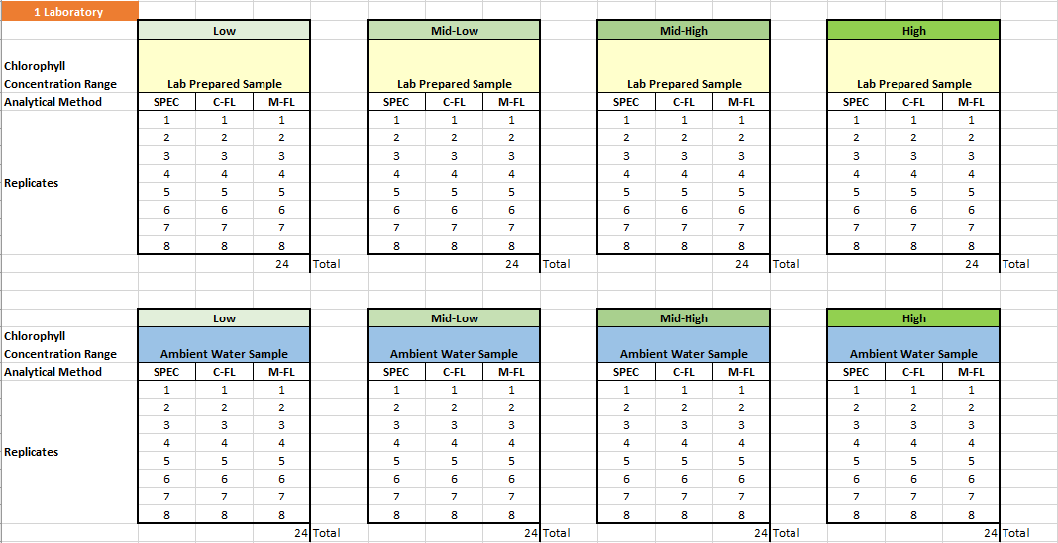
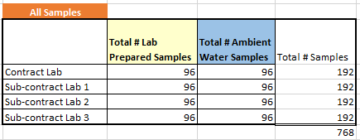
Phase I Study Design

Slide 5
Laboratory-Prepared Samples
Chlorophyll-a concentrations for laboratory-prepared standards
Low (5.0 ± 2.0 μg/L)
Mid-Low (15.0 ± 3.0 μg/L)
Mid-High (35.0 ± 5.0 μg/L)
High (70.0 ± 10.0 μg/L)

Slide 6
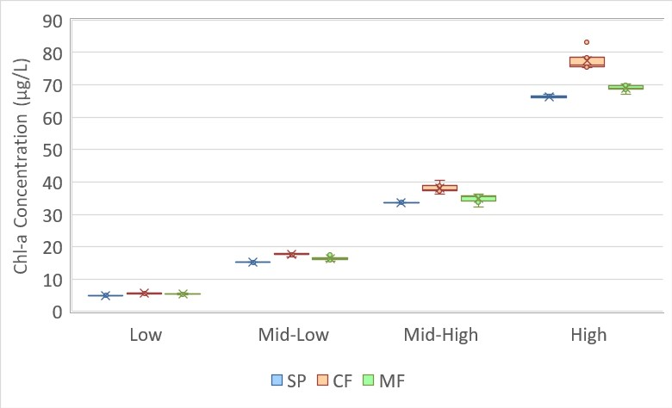
Lab-Prepared Samples: TIAER Only
A
B
C
A
B
C
A
B
C
A
B
C
Note: Whiskers are min/max; box includes 2nd and 3rd quartiles, mean, median

Slide 7
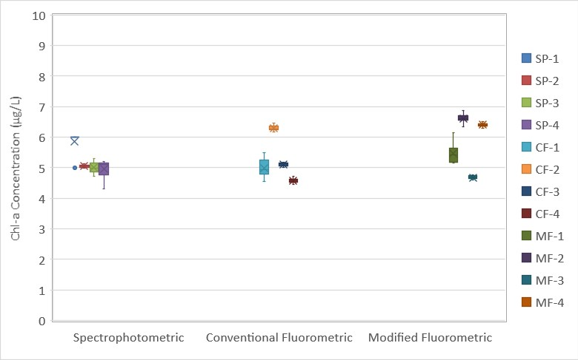
Lab-Prepared Samples: All Labs
Low Concentration
Note: Whiskers are min/max; box includes 2nd and 3rd quartiles, mean, median

Slide 8
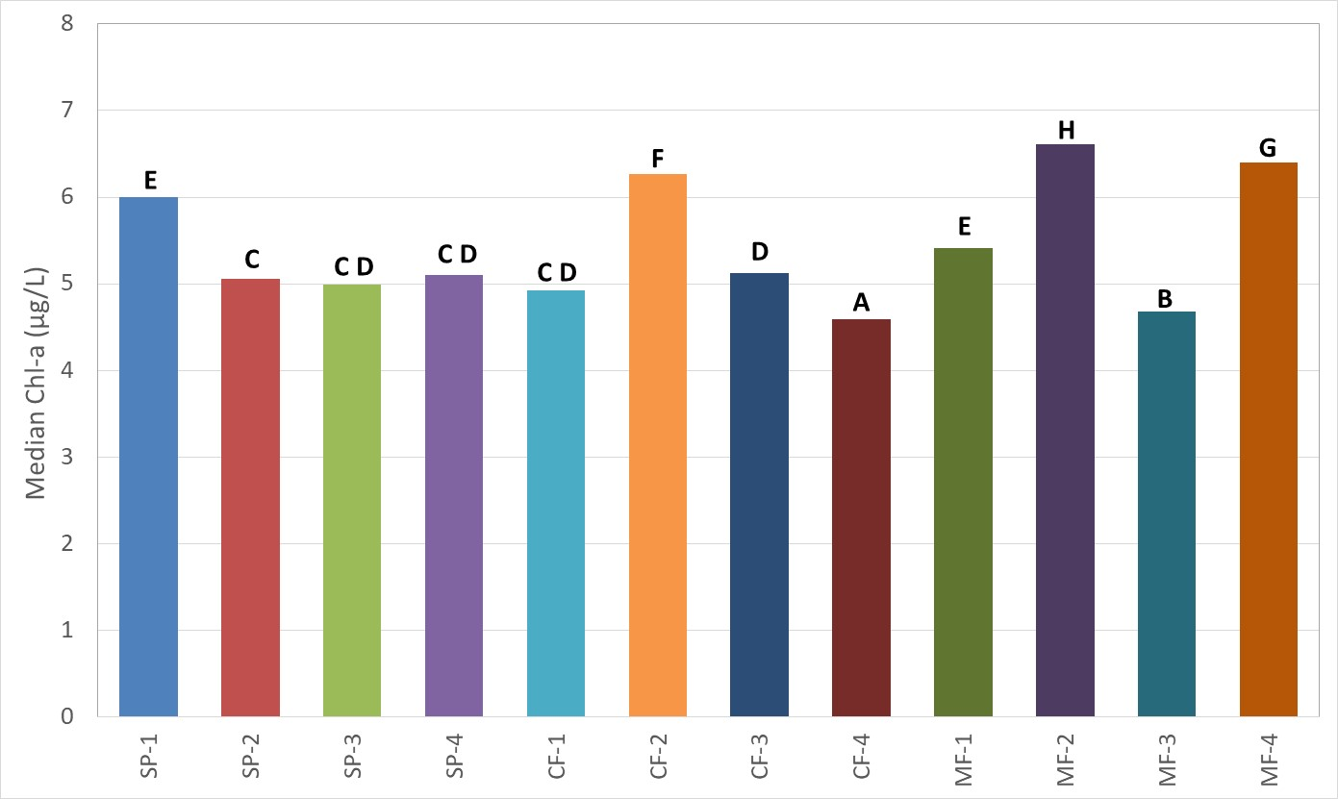
Lab-Prepared Samples: All Labs
Low Concentration

Slide 9
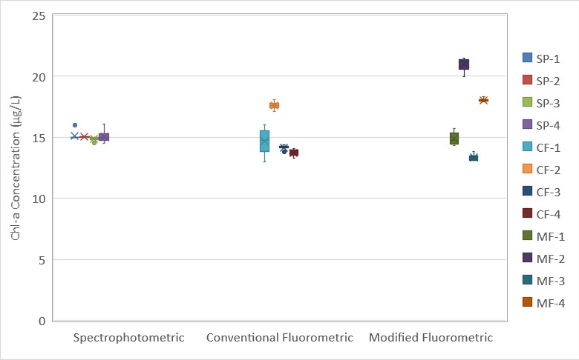
Lab-Prepared Samples: All Labs
Mid-Low Concentration
Note: Whiskers are min/max; box includes 2nd and 3rd quartiles, mean, median

Slide 10
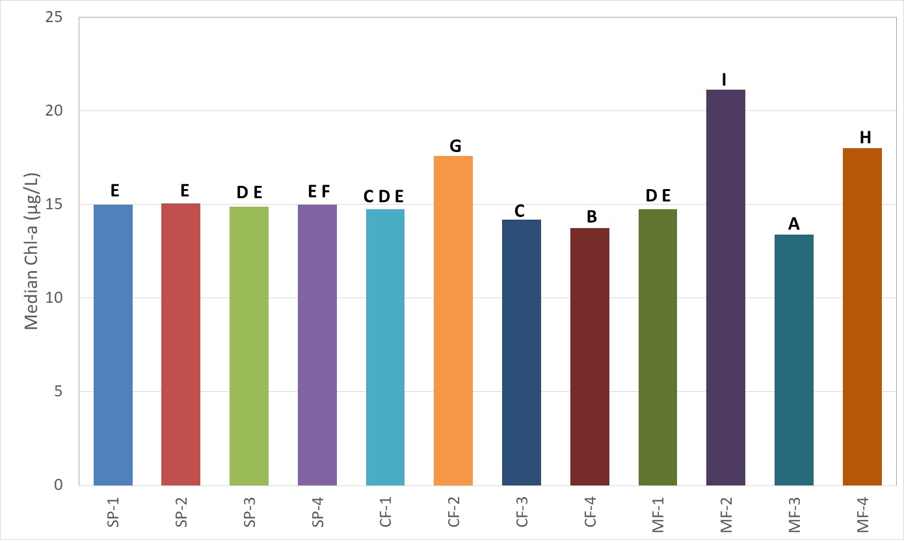
Lab-Prepared Samples: All Labs
Mid-Low Concentration

Slide 11
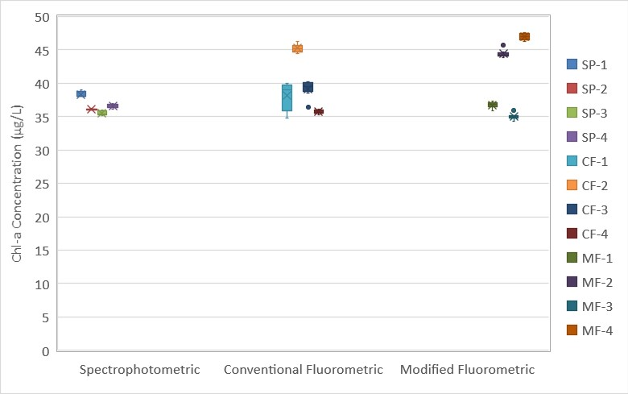
Lab-Prepared Samples: All Labs
Mid-High Concentration
Note: Whiskers are min/max; box includes 2nd and 3rd quartiles, mean, median

Slide 12
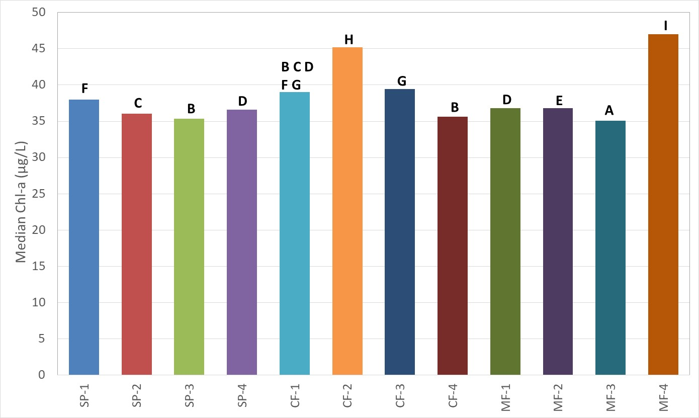
Lab-Prepared Samples: All Labs
Mid-High Concentration

Slide 13
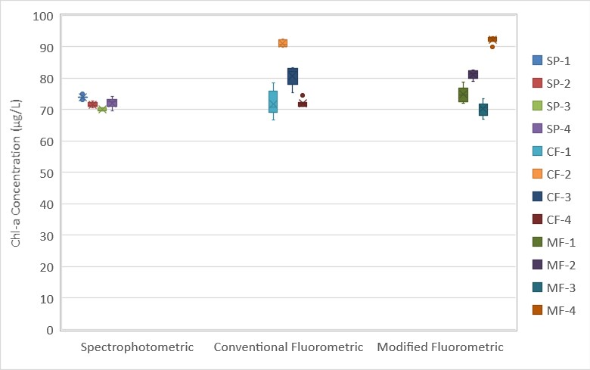
Lab-Prepared Samples: All Labs
High Concentration
Note: Whiskers are min/max; box includes 2nd and 3rd quartiles, mean, median

Slide 14
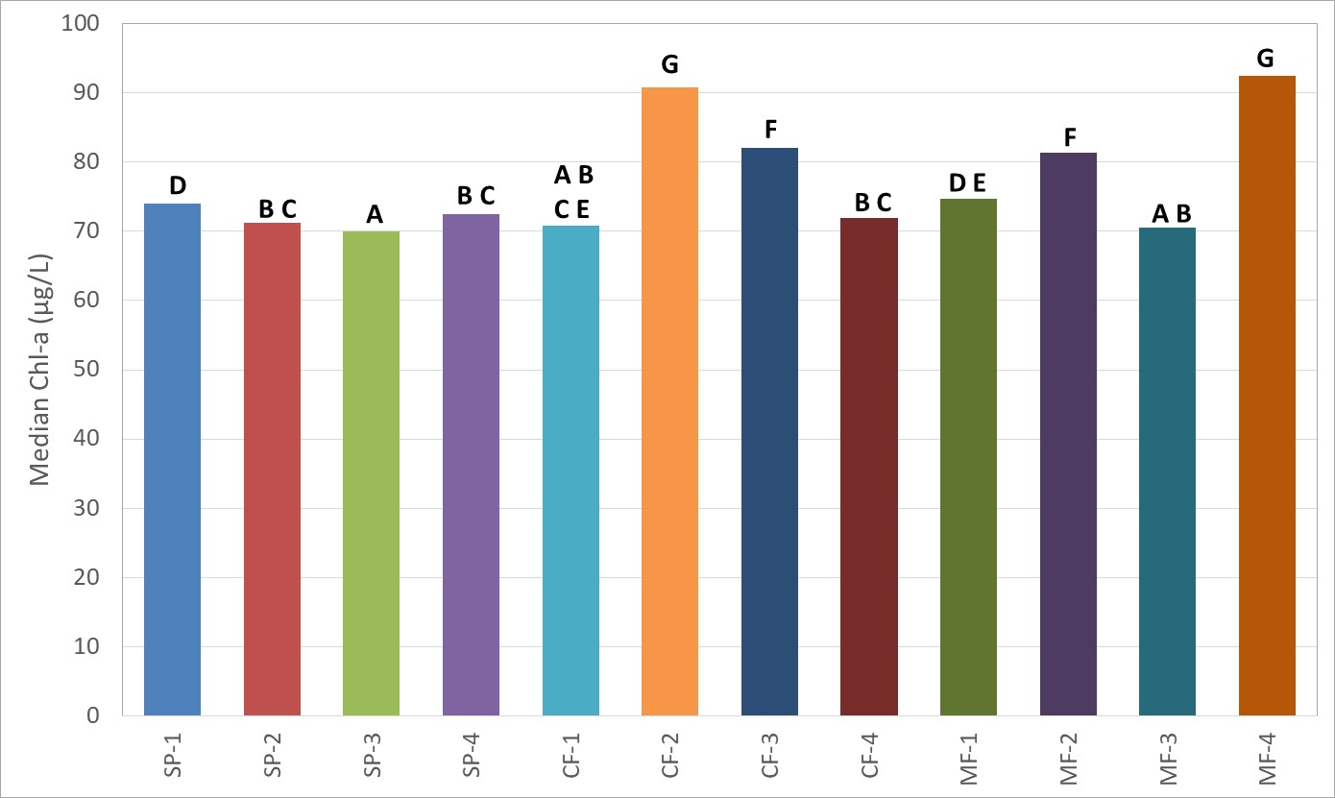
Lab-Prepared Samples: All Labs
High Concentration

Slide 15
Lab-Prepared Sample Conclusions
TIAER Only
Less variability across concentration ranges for the spectrophotometric method
Medians for each method were significantly different within each concentration category
TIAER + External Labs
Spectrophotometric results were closer to the target concentrations and more consistent within and between labs
Modified fluorometric results had the highest variability across all concentrations

Slide 16
Ambient Water Sampling
TIAER sampled separate reservoirs, each representing one of the four target concentration ranges
Used EXO sonde with chlorophyll sensor to locate the desired concentration range
Collected water samples, homogenized, separated into subsamples and delivered to external labs
Analysis performed by TIAER only and then again by all labs
Ambient samples were collected from the following waterbodies:
Lake Proctor
New Marlin City Lake
Lake Cisco
Lake Leon
Lake Wichita

Slide 17
Ambient Water Samples
Chlorophyll-a target concentrations for ambient water samples
Low (3 to 10 μg/L)
Mid-Low (10 to 25 μg/L)
Mid-High (25 to 40 μg/L)
High (> 40 μg/L)

Slide 18
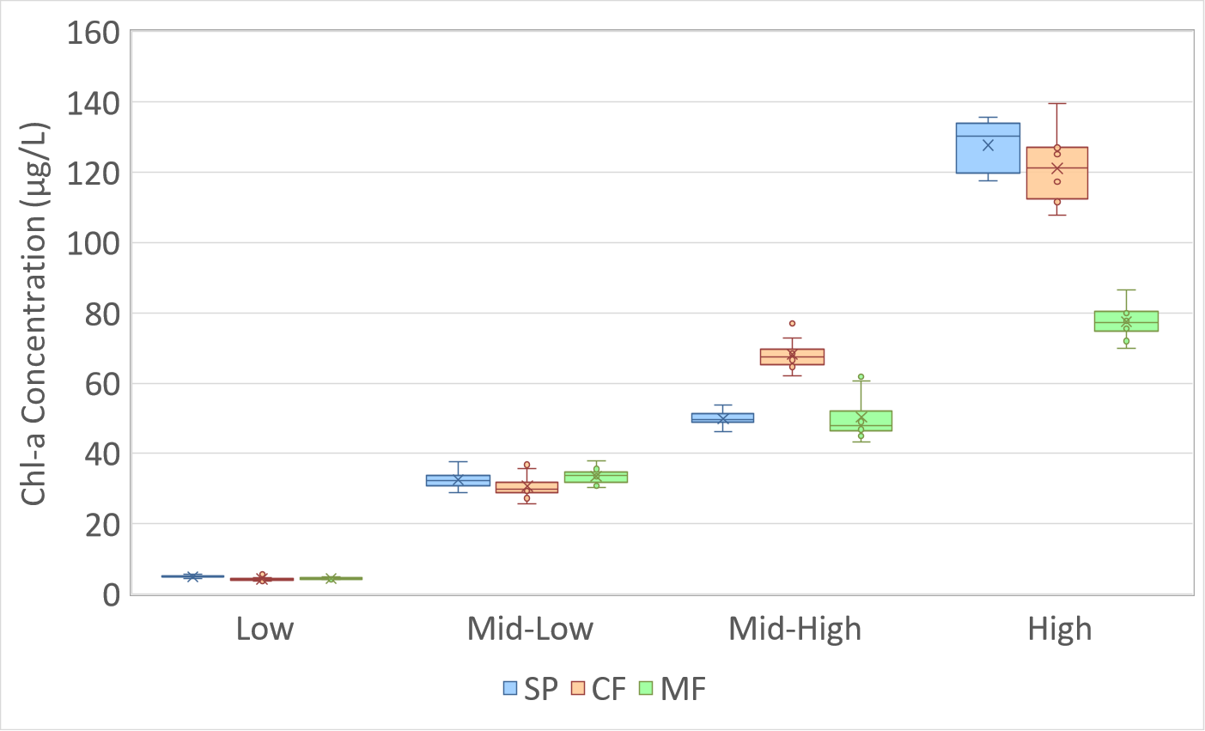
Ambient Samples: TIAER Only (1 of 2)
A
A
B
A
B
A
A
A
A
A
B
B
Note: Whiskers are min/max; box includes 2nd and 3rd quartiles, mean, median

Slide 19
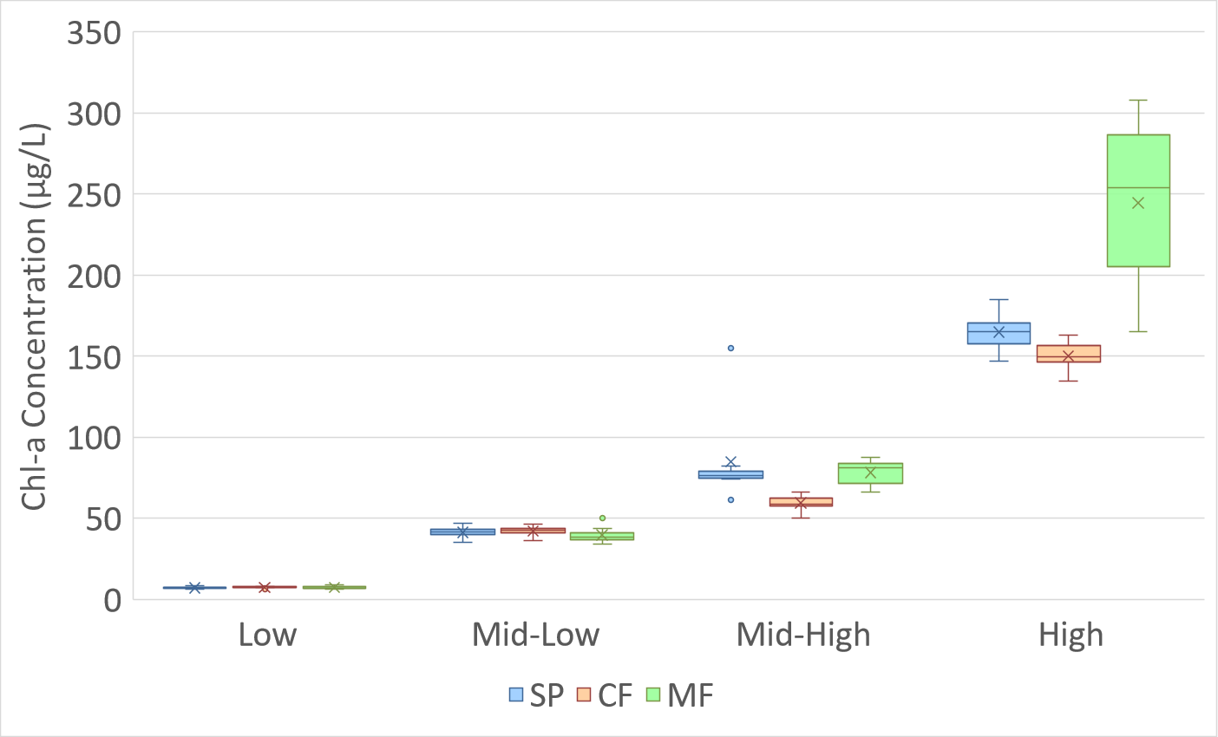
Ambient Samples: TIAER Only (2 of 2)
A
B
C
A
B
A
A
A
A
A
A
A
Note: Whiskers are min/max; box includes 2nd and 3rd quartiles, mean, median

Slide 20
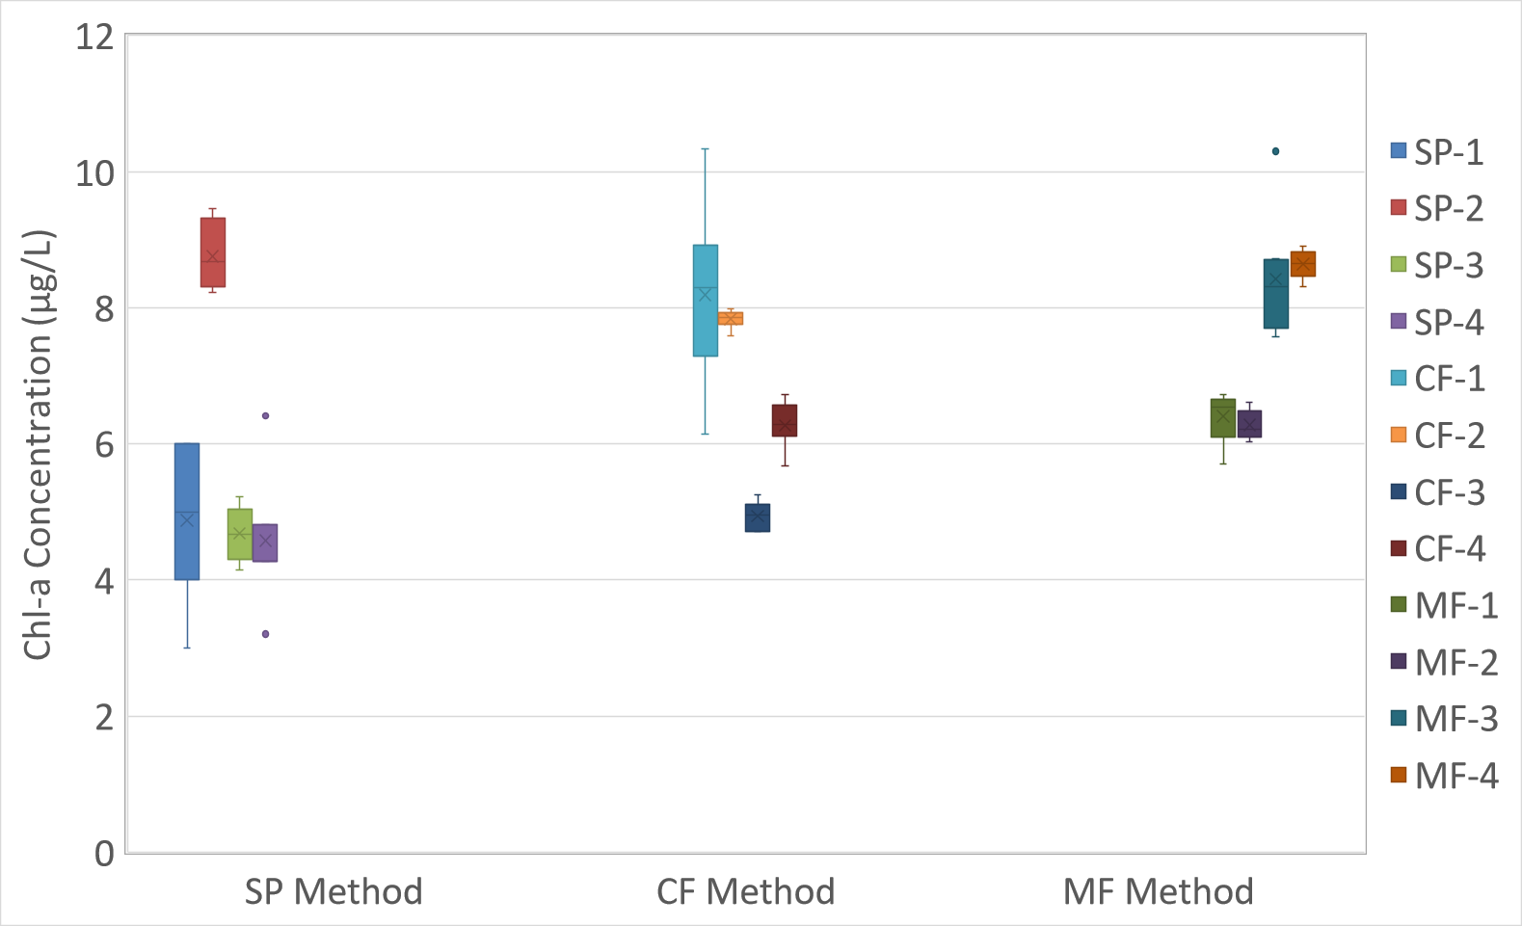
Ambient Samples: All Labs
Low Concentration
Target Concentration
3-10 µg/L
Note: Whiskers are min/max; box includes 2nd and 3rd quartiles, mean, median

Slide 21
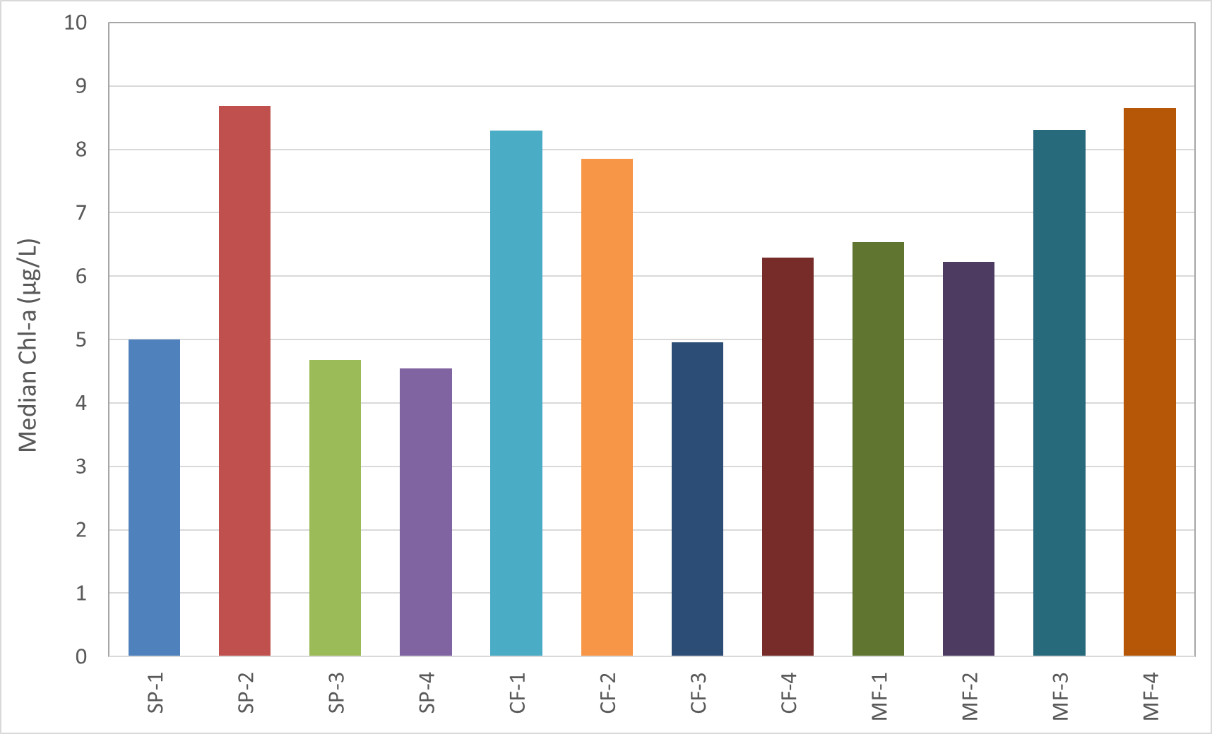
Ambient Samples: All Labs
Low Concentration
A
A
D
D
A
A
D
C
C
C
E
B
B
B
B
E

Slide 22
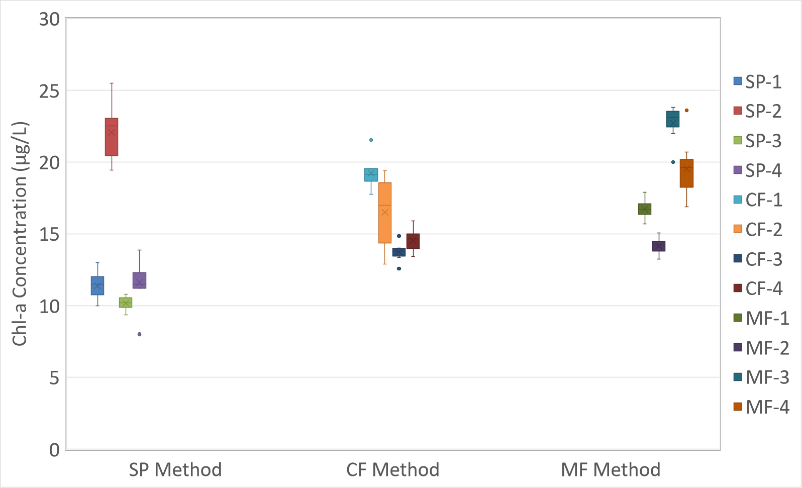
Ambient Samples: All Labs
Mid-Low Concentration
Target Concentration
10-25 µg/L
Note: Whiskers are min/max; box includes 2nd and 3rd quartiles, mean, median

Slide 23
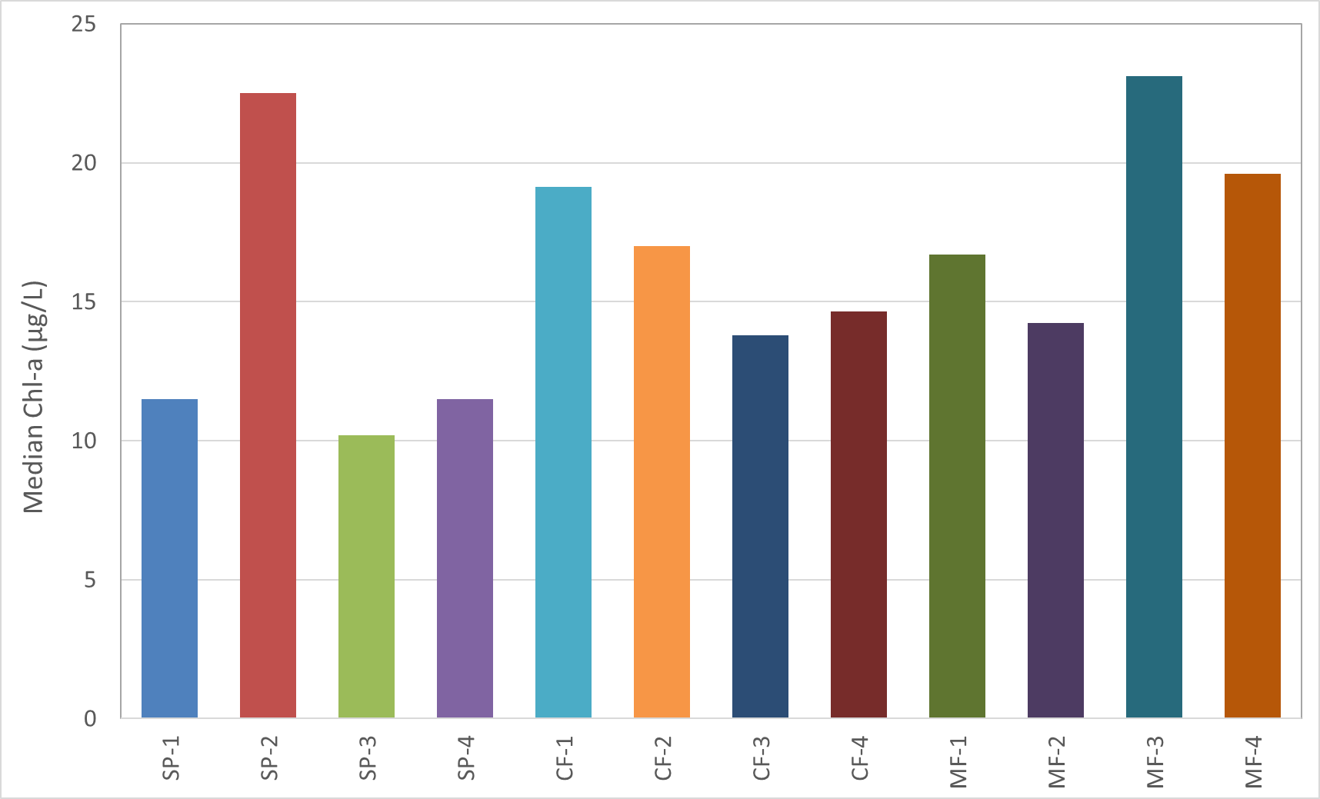
Ambient Samples: All Labs
Mid-Low Concentration
A
A
D
D
E
F
F
E
E
G
G
B
B
C

Slide 24
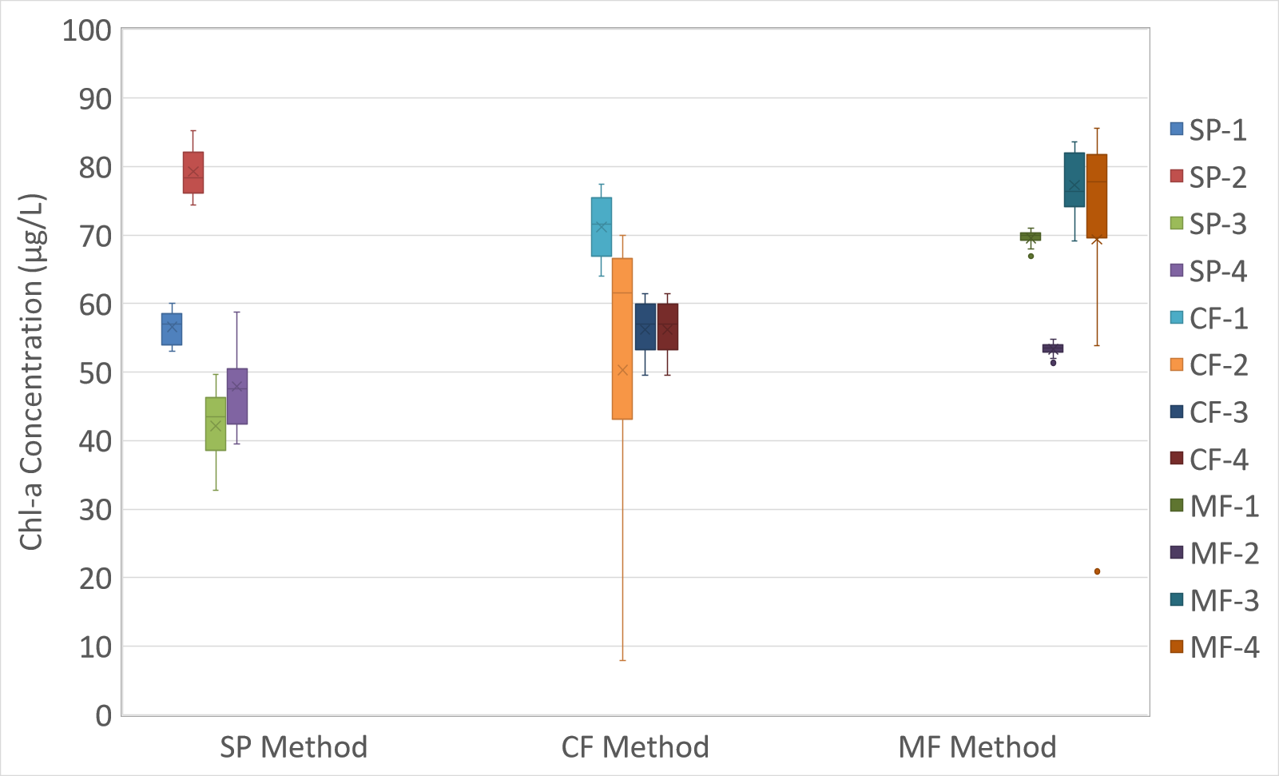
Ambient Samples: All Labs
Mid-High Concentration
Mid-High Concentration
Target Concentration
25-40 µg/L
High
Note: Whiskers are min/max; box includes 2nd and 3rd quartiles, mean, median

Slide 25
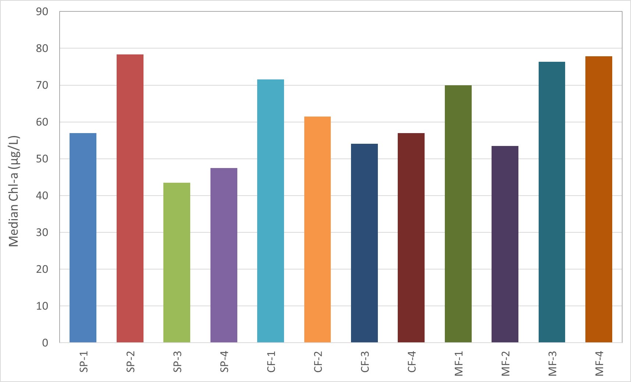
Ambient Samples: All Labs
Mid-High Concentration
High
A
A
E
A
B
E
E
E
B
C
G
B
F
H
B
B
D
F
H
G
C
C
D

Slide 26
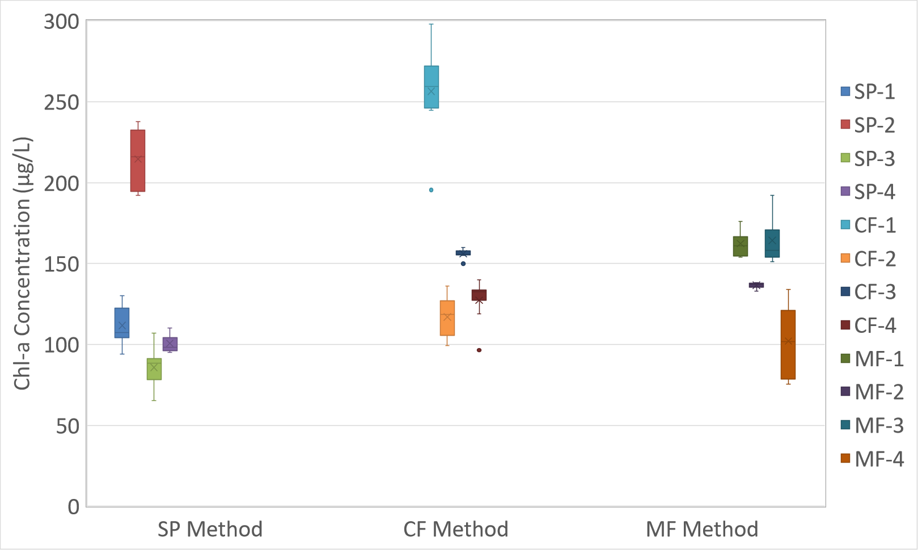
Ambient Samples: All Labs
High Concentration
Target Concentration
> 40 µg/L
Note: Whiskers are min/max; box includes 2nd and 3rd quartiles, mean, median

Slide 27
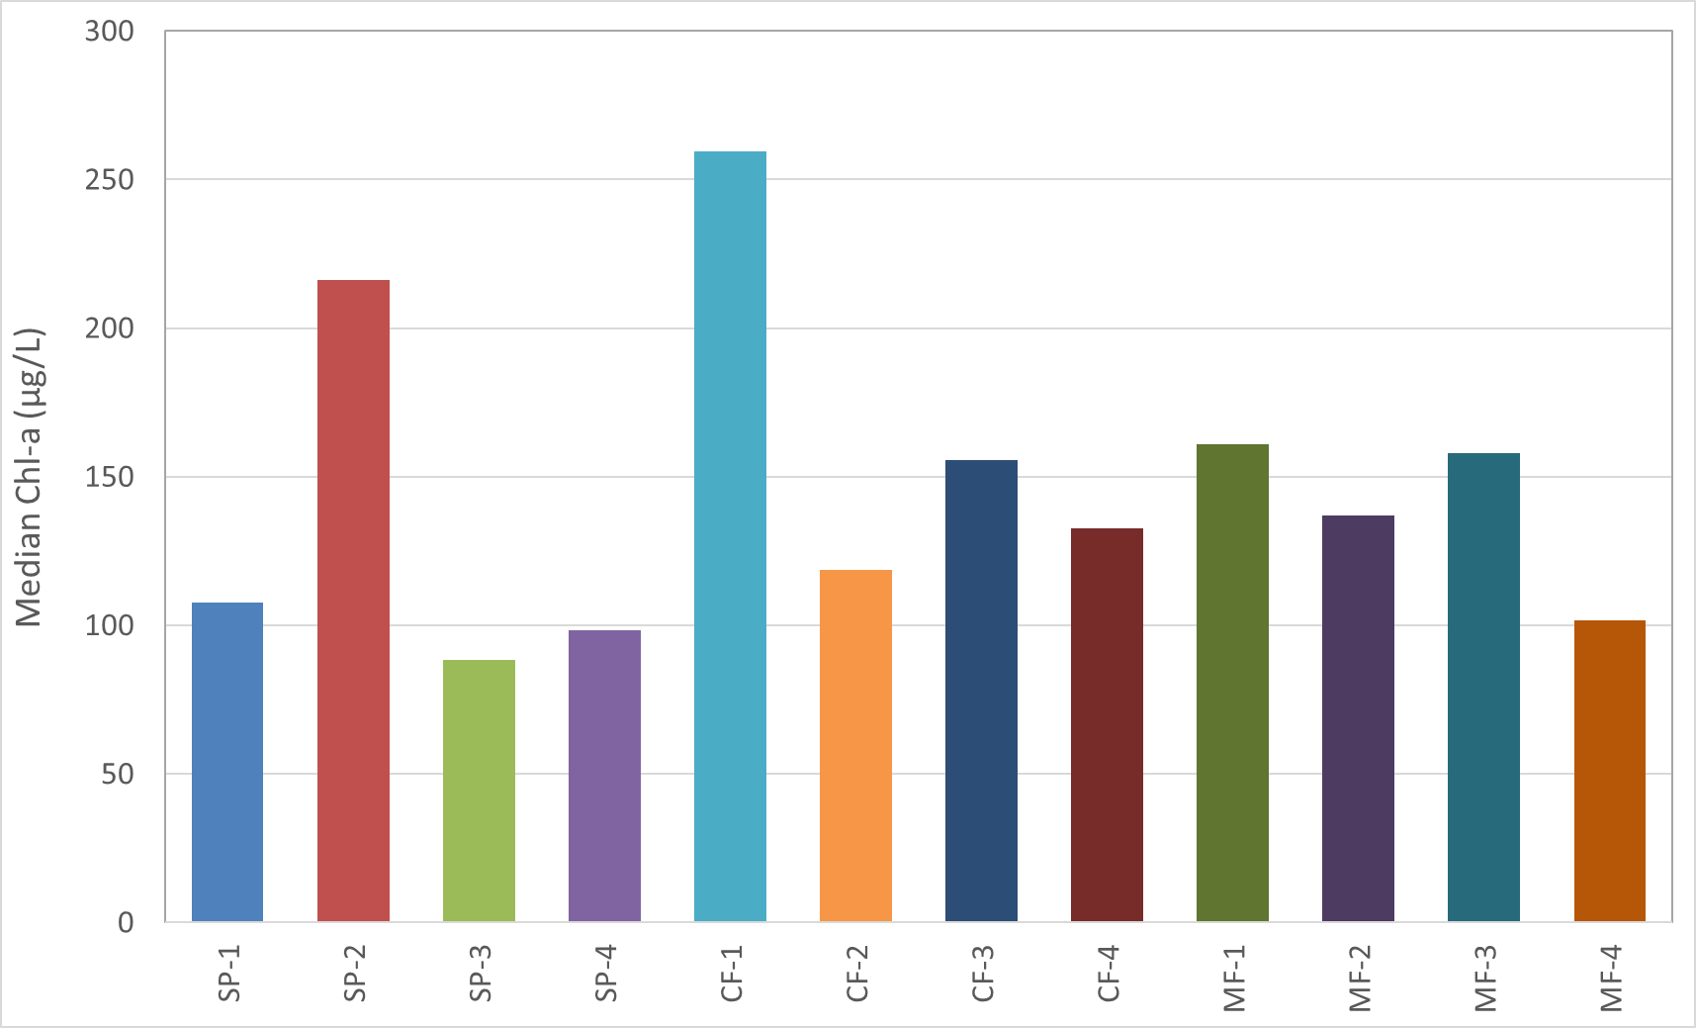
Ambient Samples: All Labs
High Concentration
D
A
F
F
F
E
G
B
E
B
B
C
B
C

Slide 28
Ambient Sample Conclusions: TIAER Only
Ambient samples were collected in April-July 2019 (2 rounds)
All concentration ranges were hit except the mid-low concentration range.
Medians in the low concentration range were similar for both fluorometric methods in the first round and similar for all methods the second round.
Medians in the mid-low concentration range were similar for all methods in both rounds.
Medians for the conventional fluorometric method were statistically different in the mid-high concentration range both rounds – higher than other methods in round one, lower than other methods in round two.
Medians in the high concentration range were similar for the spectrophotometric and conventional fluorometric methods in the first round, but all methods were statistically different in the second round.
No method performed consistently lower or higher than other methods.

Slide 29
Ambient Sample Conclusions: TIAER + External Labs
Ambient samples were collected in April-May 2019 (1 round)
All concentration ranges were hit except the mid-high concentration range.
Labs performing the spectrophotometric method produced similar results within the low concentration range, with the exception of one lab (SP-2).
One lab performing the conventional method (CF-1) produced statistically higher medians than most other labs in all concentration ranges.
The conventional and modified fluorometric methods had higher variability between labs and this was consistent across concentration ranges.
With the exception of one lab (SP-2), the spectrophotometric method produced lower results than both fluorometric methods across all concentration ranges.
Individual labs performed consistently across concentrations, but were highly variable compared each other and across methods.

Slide 30
Future Directions: Phase II in FY20-21
Analysis of ambient water within four concentration ranges – two rounds each (repeat Phase I, but labs also report pheophytin-a)
TIAER only round will include standard field collection and field filtering
TIAER + External labs will include standard field collection only
Analysis of ambient water with temporal sampling
TIAER analyze samples monthly (12 events) from three water bodies
External labs analyze samples quarterly (4 events) from two water bodies
If funding allows, this may be expanded to include more labs but have fewer reps
Analyze relationships between YSI EXO in-situ readings and lab results
Investigate possible modifications to all lab’s standard operating procedures for each of the chlorophyll-a methods

